Slide 1
AI, Cloud & Modern Workplace Conference 2025
20, 21 & 22 February 2025 , Online Conference
"Empowering Tomorrow: Innovate, Integrate, Inspire
at AI, Cloud & Modern Workplace Conference 2025"

Slide 2
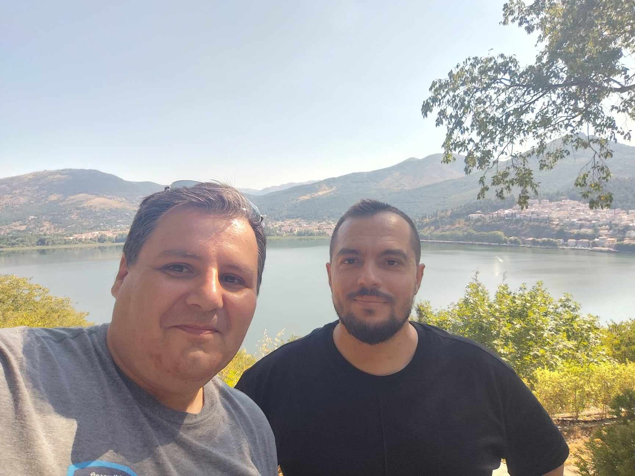
AI, Cloud & Modern Workplace Conference 2025
20, 21 & 22 February 2025 , Online Conference
Digital Innovation Minds Tech Community - Organizers
George Chrysovalantis Grammatikos
Konstantinos Boutsioulis

Slide 3
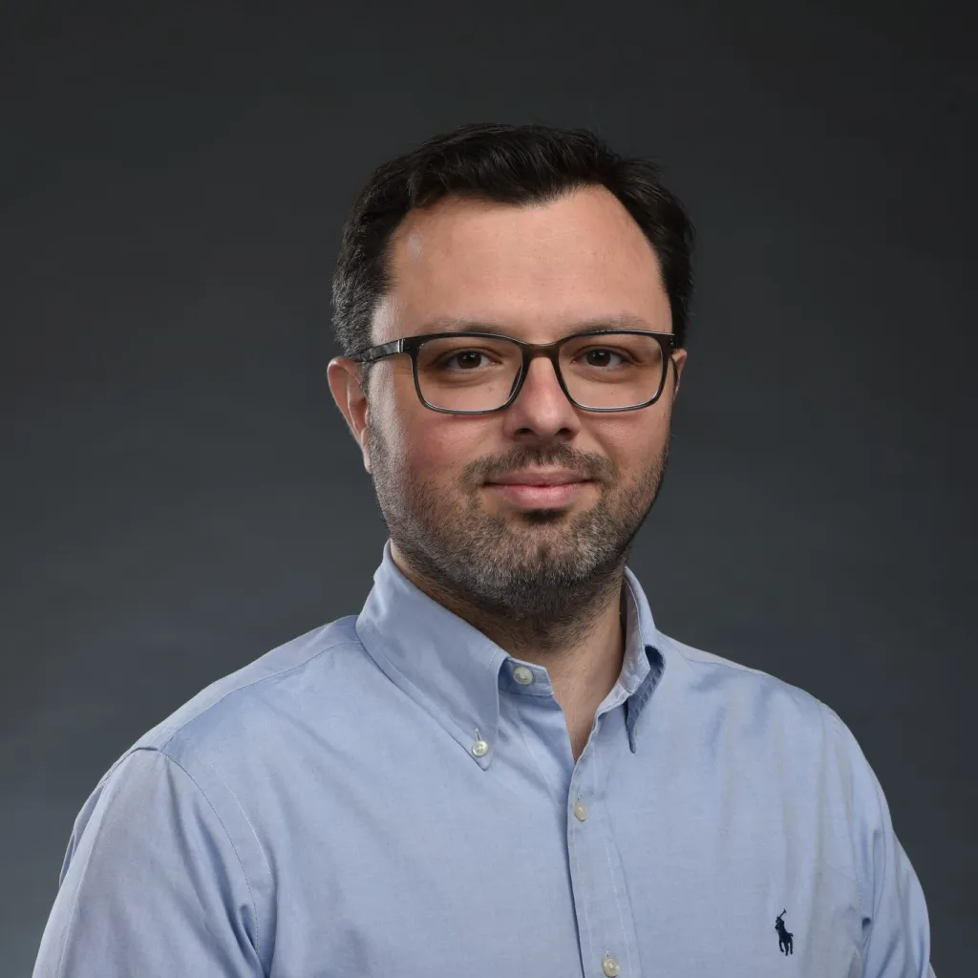
AI, Cloud & Modern Workplace Conference 2025
20, 21 & 22 February 2025 , Online Conference
Elevating Regulatory Compliance with Microsoft's SIEM and XDR Technologies Powered by Actionable Threat Intelligence
Friday February 21st 2025 , 18:00 – 19:00 (GMT+2)
Michalis Michalos
Microsoft MVP – Security (SIEM & XDR)

Slide 4

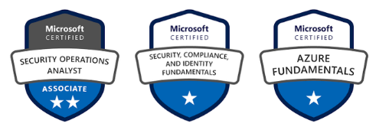
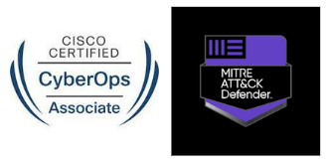
whoami
Currently working as Cyber Resilience & Intelligence Manager @ Alpha Bank
Over 12 years experience in ICT
Working in Cybersecurity since 2019
Electrical Engineer BSc, MSc, MBA
Father of 2, lifetime Scout, own a wine cooler, and a watch enthusiast

Slide 5

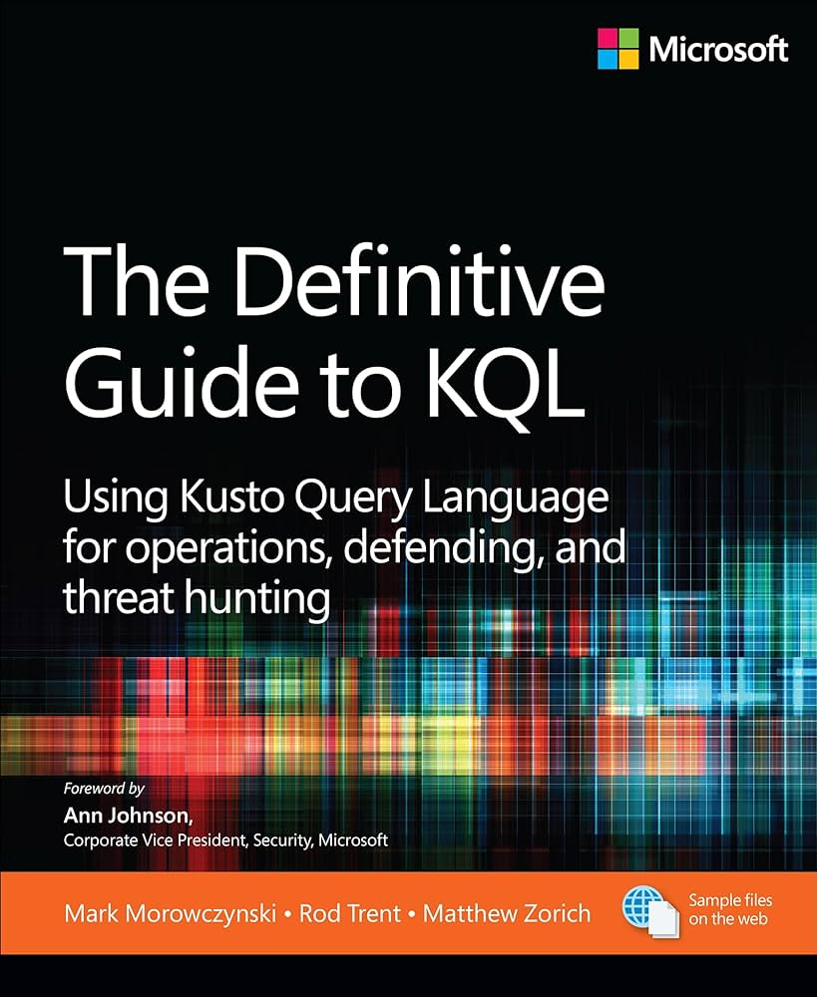


Projects & Community Curation
Blogging at michalos.net
github.com/cyb3rmik3/KQL-threat-hunting-queries
github.com/cyb3rmik3/MDE-DFIR-Resources
Featured in:

Slide 6
Agenda
The challenge!
What is TI and how it helps?
Microsoft Defender Threat Intelligence
Custom detections based on TI feeds
MISP Integration
Other things to do
Closing remarks

Slide 7

Continuous Monitoring: All three frameworks emphasize the need for tools and processes to proactively monitor systems for threats, including anomaly detection, vulnerability scanning, and log analysis.
Incident Detection and Response: Focus on detecting threats early and responding promptly.
Threat Intelligence: Leveraging internal and external intelligence to stay ahead of emerging risks.
By adhering to these requirements, organizations can maintain a proactive posture to detect and prevent cybersecurity threats effectively.
Challenge: Common themes across ISO27k1, NIS2 and DORA

Slide 8
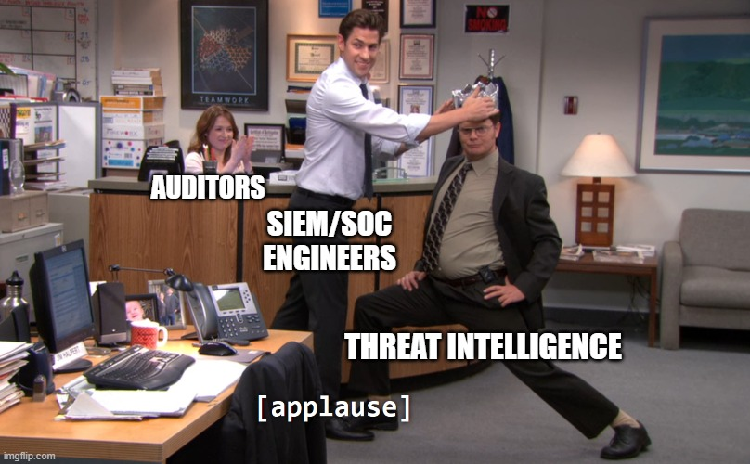
Oh yeah!

Slide 9

What is Cyber Threat Intelligence?
Cyber threat intelligence is information that helps organizations better protect against cyberattacks.
It includes data and analysis that give security teams a comprehensive view of the threat landscape so they can make informed decisions about how to prepare for, detect, and respond to attacks.
Microsoft

Slide 10

How and why Threat Intelligence feeds can help?
A threat intelligence feed is a real-time, continuous data stream that gathers information related to cyber risks or threats.
They are the cornerstone of proactive threat detection and response. They enable security teams to:
Address security threats before they escalate into major issues.
Proactively identify and mitigate threats.
Recorded Future, CrowdStrike

Slide 11
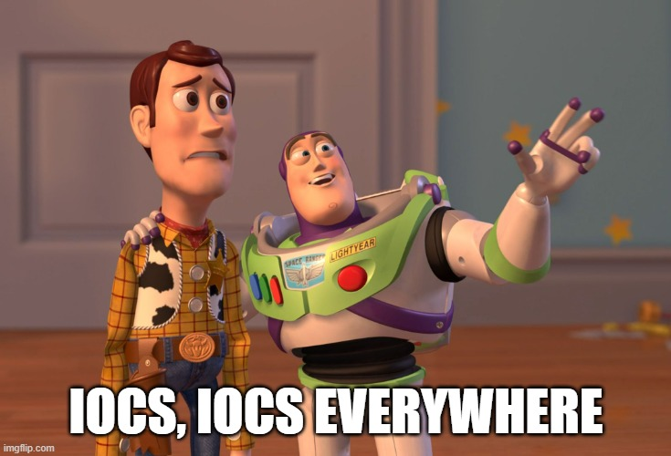
Where do we start?

Slide 12
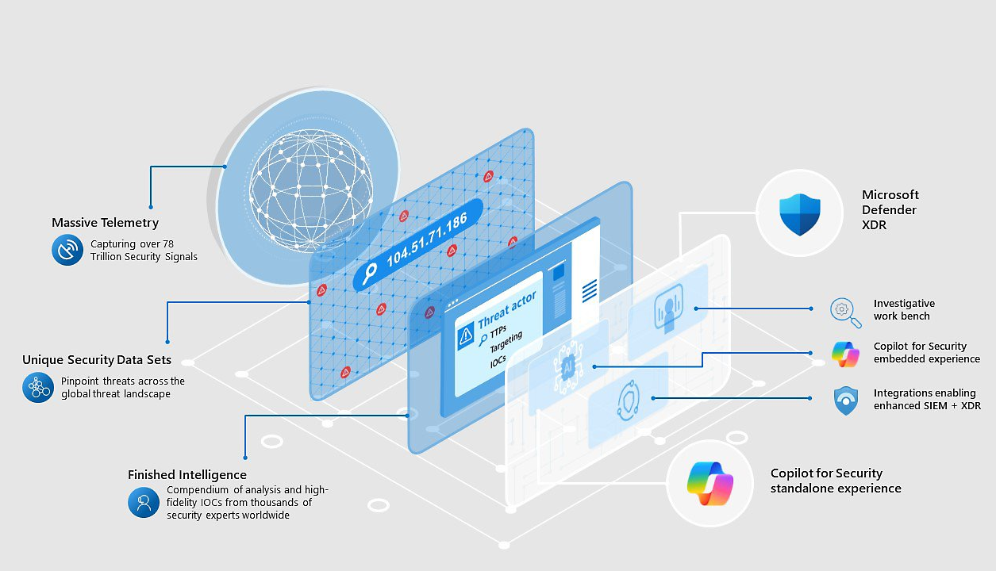
Microsoft Defender Threat Intelligence
Microsoft Defender Threat Intelligence
Free and Premium through Microsoft Unified SecOps.
Data connector available for free at Content hub.
Easy to use, analytics available.
ThreatIntelligenceIndicator table.

Slide 13
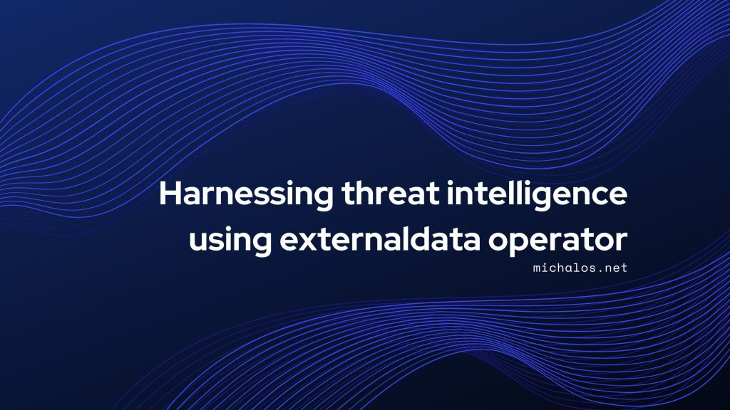
Custom detections based on intelligence feeds
Custom analytics
Requires KQL skills to steward externaldata operator.
You need to find relevant sources.
Are they really valuable?

Slide 14
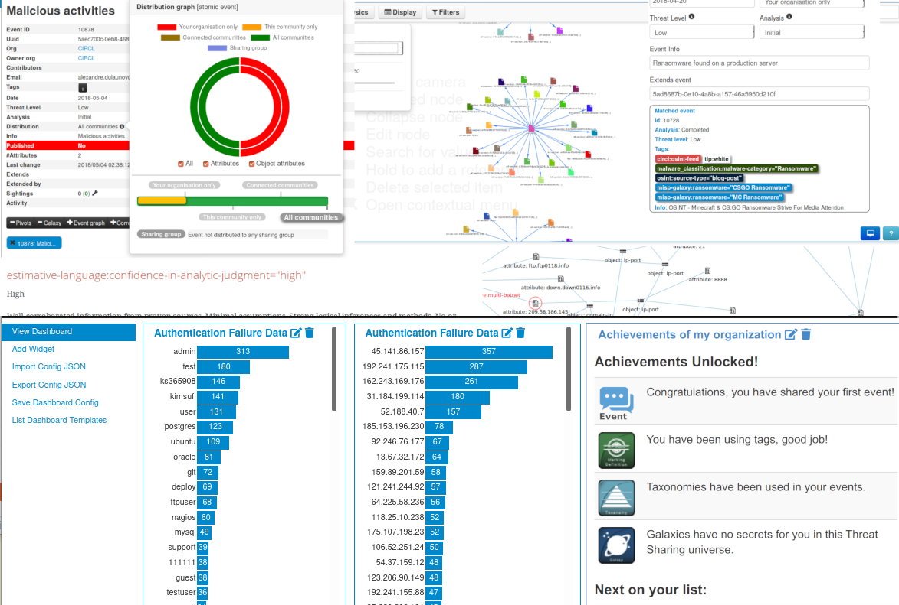
MISP
Integrate MISP with Sentinel using misp2sentinel
Requires a MISP (surprised?) and a lot of curation.
Relatively easy onboarding.
Unfortunately, not a 2-way channel communication.
Feeds IoCs at ThreatIntelligenceIndicator table.

Slide 15
Other things to do?
Automate
Use threat intelligence to enrich your incidents
Build use cases with Security Copilot
Build playbooks for incident response
Proactive threat hunting with platforms like SOC Prime or Cyborg

Slide 16
Closing remarks
Threat Intelligence without curation, Greek summer without χωριάτικη (Greek Salad)
Document, evaluate and assess
Long-term thinking while building things
Don’t use everything you see online!
Evaluate and decide on your choices/sources given

Slide 17

Thank you
michalos.net
linkedin.com/in/mmihalos
Presentation and references will be uploaded at:
github.com/cyb3rmik3

